Slide 1

Infinite Loops

Slide 2
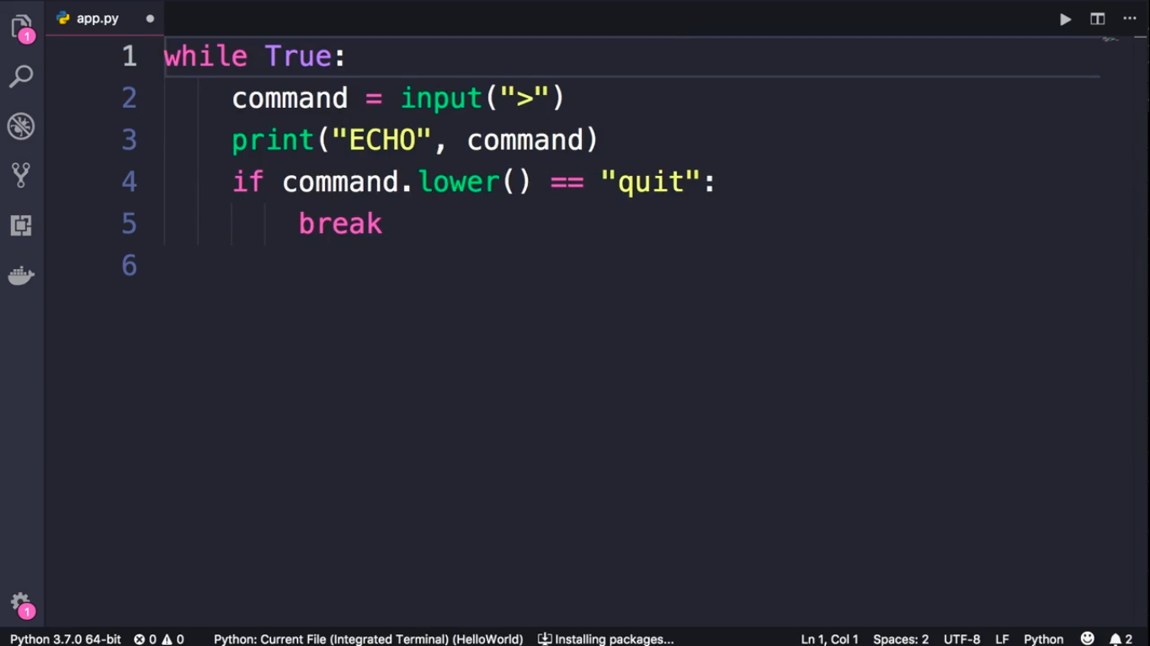

Slide 3
